Slide 1
Regression Analysis in R
Presentation for R-Ladies Milan
Ana Peña

Slide 2
Learning Objectives
Basic theories and concepts of regression analysis
How to build and compare regression models
How to interpret results
How to perform regression in R

Slide 3
Outline and Scope
Introduction to Regression Analysis
Simple Linear Regression (Sample case)
Multiple Linear Regression (Sample case)
Interpretation of Results in R

Slide 4
Introduction to Regression Analysis

Slide 5
What is Regression Analysis
Regression Analysis
Regression analysis is a form of predictive modelling technique which investigates the relationship between a dependent (target) and independent variable (s) (predictor).
This technique is used for forecasting, time series modelling and finding the causal effect relationship between the variables.
Definition
When or why do we use regression
Business value
Types of regression
Notes:
regression analysis estimates the relationship between two or more variables

Slide 6
What is Regression Analysis
Why do we use regression analysis
It indicates the significant relationships between dependent variable and independent variable.
It indicates the strength of impact of multiple independent variables on a dependent variable.
Definition
When or why do we use regression
Business value
Types of regression
Notes:
There are multiple benefits of using regression analysis. They are as follows:
Regression analysis also allows us to compare the effects of variables measured on different scales,
Examples:
such as the effect of price changes and the number of promotional activities.
GIVE OR ASK OTHER EXAMPLES
It is used in different sectors
Primary example is of course, in determining economic indicators or forecasts values of GDP, money supply, population in which the central bank or the government can use this as the basis for a policy decision or an economic program in general
In the financial sector, it’s the same, in determining level of investments and what affects it, examining the trends in interest rates and predicting them, etc.

Slide 7
What is Regression Analysis
Value?
Definition
When or why do we use regression
Business value
Types of regression
Notes:
These benefits help market researchers / data analysts / data scientists to eliminate and evaluate the best set of variables to be used for building predictive models.

Slide 8
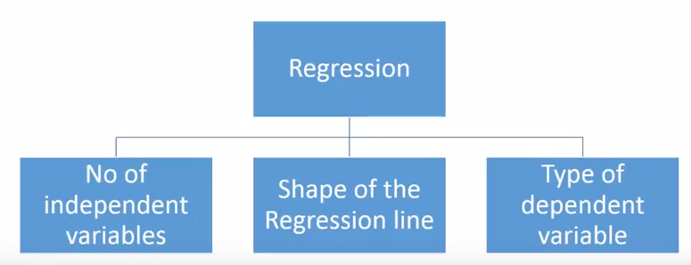
What is Regression Analysis
Types of Regression
What are the types of regression techniques do we have?
There are various kinds of regression techniques available to make predictions. These techniques are mostly driven by three metrics (number of independent variables, type of dependent variables and shape of regression line).
Definition
When or why do we use regression
Business value
Types of regression

Slide 9
What is Regression Analysis
Commonly Used Regressions
Linear Regression
Logistic Regression
Polynomial Regression
Stepwise Regression
Ridge Regression
Lasso Regression
ElasticNet Regression
Definition
When or why do we use regression
Business value
Types of regression

Slide 10
Linear Regression
Linear regression establishes a relationship between dependent variable (Y) and one or more independent variables (X) using a best fit straight line (also known as regression line).
Y = a + b*x + e
where a is intercept, b is slope of the line and e is error term. This equation can be used to predict the value of target variable based on given predictor variable(s).
Linear equation, each independent variable is multiplied by the coefficients and summed up to form the predicted or the dependent variable
Basic concepts
Definition
Geometrical representation
Line of best fit
Notes:
A linear regression is the simplest non-trivial relationship.
Linear = A mathematical equation in which no independent-variable is raised to a power greater than one. A simple linear function with only one independent variable (y = a + bx) traces a straight line when plotted on a graph. Also called linear equation.
LINEAR REGRESSION
Is a linear approximation of a causal relationship between two or more variables
They are one of the most common ways to make inferences in predictions
The process is that you get sample data, design a model that works for the sample, and make predictions for the whole population.
You have the DEPENDENT and INDEPENDENT (PREDICTORS)
Y= f (x1, x2, x3,….)
The regression model is a linear approximation of this regression model

Slide 11
Linear Regression
How can you verify if the relationship between 2 variables is linear?
Basic concepts
Definition
Geometrical representation
Line of best fit
Notes:
The easiest way is to choose an independent variable and dependent variable and plot it on a scatterplot
If the datapoints for a pattern that is close to a straight line, then a linear regression is suitable.

Slide 12
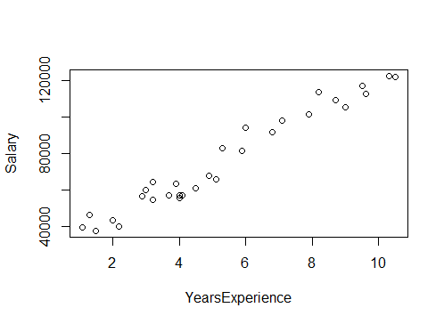
Linear Regression
Geometrical Representation
Basic concepts
Definition
Geometrical representation
Line of best fit
Notes:
INSERT SCATTERPLOT OF SAMPLE EXERCISE

Slide 13
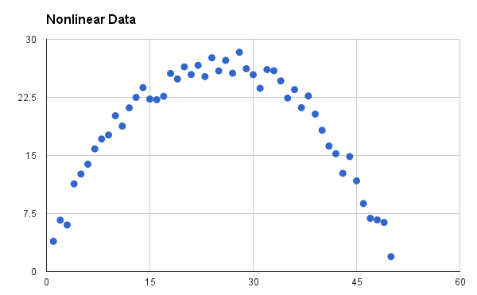
Linear Regression
Geometrical Representation
Basic concepts
Definition
Geometrical representation
Line of best fit
Notes:
INSERT SCATTERPLOT OF SAMPLE EXERCISE

Slide 14
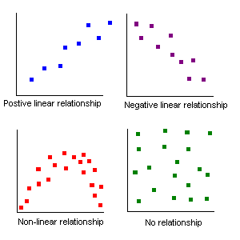
Linear Regression
Geometrical Representation
Basic concepts
Definition
Geometrical representation
Line of best fit
Notes:
INSERT SCATTERPLOT OF SAMPLE EXERCISE

Slide 15
Linear Regression
How to obtain best fit line
(Values of a and b)
Ordinary Least Square
(OLS) Method
It calculates the best-fit line for the observed data by minimizing the sum of the squares of the vertical deviations from each data point to the line.
Basic concepts
Definition
Geometrical representation
Line of best fit
Notes:
It is the most common method used for fitting a regression line.
Because the deviations are first squared, when added, there is no cancelling out between positive and negative values.
How to obtain best fit line (Value of a and b)?
This task can be easily accomplished by Ordinary Least Square (OLS) Method
It calculates the best-fit line for the observed data by minimizing the sum of the squares of the vertical deviations from each data point to the line.

Slide 16

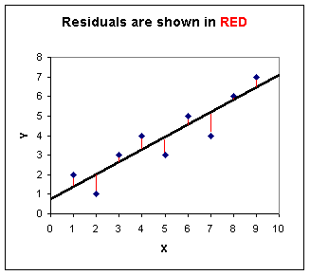
Linear Regression
Ordinary Least Square (OLS)
The Least Squares Regression Line
Basic concepts
Definition
Geometrical representation
Line of best fit
Notes:
OLS = MIN SSE (will be discussed later on )
Finding the line of best fit through OLS means determing the line (among many lines that can fit our data) with less error.
This is a minimization problem using Calculus and Algebra so I will not elaborate on this.
OLS is a powerful method in finding the best fit line
The Least Squares Regression Line is the line which minimizes the sum of the square or the error of the data points. (See the graph below.)

Slide 17
Linear Regression
Ordinary Least Square (OLS)
Notice that the graph to the right shows several features: The actual data points (x,y) are the blue dots.
The Least Squares Regression Line of the dependent (y) variable based on the independent (x) variable is shown in black.
The errors (residuals) are the vertical distances between the observed values of y and the predictions of the "line of best fit," which are shown in red.
The goal, in general, is to minimize the errors from the actual data to the regression line. The least squares line minimizes the sum of the square of the errors.
Basic concepts
Definition
Geometrical representation
Line of best fit
Notes:
OLS = MIN SSE (will be discussed later on )
Finding the line of best fit through OLS means determing the line (among many lines that can fit our data) with less error.
This is a minimization problem using Calculus and Algebra so I will not elaborate on this.
OLS is a powerful method in finding the best fit line
Error is the difference between prediction and reality: the vertical distance between a real data point and the regression line. OLS is concerned with the squares of the errors. It tries to find the line going through the sample data that minimizes the sum of the squared errors. Below, the squared errors are represented as squares, and your job is to choose betas (the slope and intercept of the regression line) so that the total area of all the squares (the sum of the squared errors) is as small as possible. That's OLS! Website: http://setosa.io/ev/ordinary-least-squares-regression/
B coefficients are found by minimizing the error of the prediction
But how do we actually minimize the error?

Slide 18
Simple Linear Regression Analysis
Notes:
What we really want to see is
The regression equation
Significance
Explanatory power

Slide 19
Simple Linear Regression
Simple linear regression is a statistical method that allows us to summarize and study relationships between two quantitative variables:
Y = βο + β₁ x ₁ + Ɛ
βο = intercept
β₁ = is the coefficient that stands before the independent variable x, which quantifies the effect of x (education) on y (income).
E.g. if β₁ is 2000 euro, that means that for every year of education, you get additional 2000 euro in income.
Epsilon represent the error of the model. Or it is the actual difference between the observed or actual income to the predicted value.
Definition
Basic concepts
Significance, Variance, Coefficients
Application in R
Interpretation of results
Synthesis
Notes:
Simple linear regression gets its adjective "simple," because it concerns the study of only one predictor variable. In contrast, multiple linear regression, which we study later in this course, gets its adjective "multiple," because it concerns the study of two or more predictor variables.
In this equation we want to predict the value of y, provided we have the value of x. but of course to have a regression, y must depend on x in some causal way.
Whenever there is a change in x, such change must translate in some change in y.
For example, income depends on education an other variables. There is a causal relationship, the more income you get, the more likely that your education is higher. (But of course in reality it does depend on a lot of factors, so in regression we can see by how much, so maybe it only account for little, or more)
This is something trivial….

Slide 20
Simple Linear Regression
Linear Regression Equation
ŷ = bο + b₁ x ₁
ŷ = is the estimate or the predicted value,
bο = is the estimate of the constant beta 0
b₁ = quantifies the effect of x to y
One variable, denoted x, is regarded as the predictor, explanatory, or independent variable.
The other variable, denoted y, is regarded as the response, outcome, or dependent variable.
Definition
Basic concepts
Significance, Variance, Coefficients
Application in R
Interpretation of results
Synthesis
Notes:
THAT IS A POPULATION FORMULA, in practice we use the linear regression equation
Because the other terms are used less frequently today, we'll use the "predictor" and "response" terms to refer to the variables encountered in this course. The other terms are mentioned only to make you aware of them should you encounter them in other arenas.
On average the error is 0, if you earn more that what the regression predicted, others earn less than the predicted value, so it evens out.

Slide 21
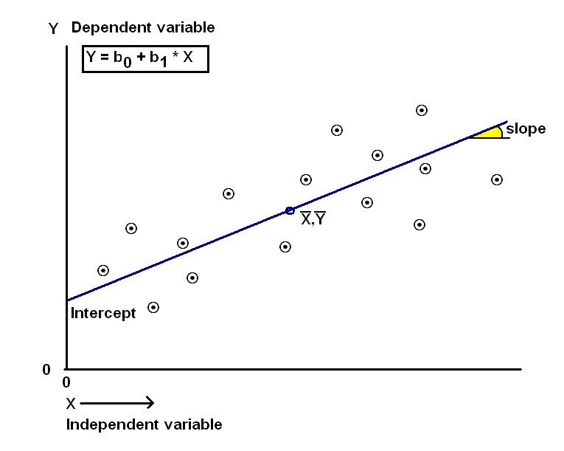
Simple Linear Regression
Linear Regression Equation
ŷ = bο + b₁ x ₁
Definition
Basic concepts
Significance, Variance, Coefficients
Application in R
Interpretation of results
Synthesis
Notes:
THAT IS A POPULATION FORMULA, in practice we use the linear regression equation
Because the other terms are used less frequently today, we'll use the "predictor" and "response" terms to refer to the variables encountered in this course. The other terms are mentioned only to make you aware of them should you encounter them in other arenas.
On average the error is 0, if you earn more that what the regression predicted, others earn less than the predicted value, so it evens out.

Slide 22
Simple Linear Regression
Measure of the goodness of fit
R²
Coefficient of determination
R-squared is a statistical measure of how close the data are to the fitted regression line
Percentage of variability explained by your datasets or your model
R² = SSR / SST
R²= Variability explained by the regression / Total variability of the data set
What is the range
Definition
Basic concepts
Significance, Variance, Coefficients
Application in R
Interpretation of results
Synthesis
Notes:
You need to determine how well the model fits the data
Remember that Linear regression calculates an equation that minimizes the distance between the fitted line and all of the data points. Technically, ordinary least squares (OLS) regression minimizes the sum of the squared residuals. In general, a model fits the data well if the differences between the observed values and the model's predicted values are small and unbiased.
What Is R-squared?
R-squared is a statistical measure of how close the data are to the fitted regression line. It is also known as the coefficient of determination, or the coefficient of multiple determination for multiple regression.
The definition of R-squared is fairly straight-forward; it is the percentage of the response variable variation that is explained by a linear model.
Or:
R-squared = Explained variation / Total variation
R-squared is always between 0 and 100%:
0% indicates that the model explains none of the variability of the response data around its mean.
100% indicates that the model explains all the variability of the response data around its mean.
In general, the higher the R-squared, the better the model fits your data. However, there are important conditions for this guideline that I’ll talk about both in this post and my next post.
R square - actually measure the % of variability in your dependent variable that is accounted for or can be explained by your independent variables or your model
So we can use this to compare our models
R square ranges from 0 to 1
What is the range of a good R square
INSERT Background on SST = SSE + SSR
Part of ANOVA
Note that despite that measure, we still have to find the more practical approach of reasons for variability

Slide 23
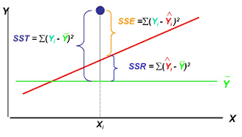
Simple Linear Regression
Measure of the goodness of fit
Definition
Basic concepts
Significance, Variance, Coefficients
Application in R
Interpretation of results
Synthesis
Notes:
You need to determine how well the model fits the data
Remember that Linear regression calculates an equation that minimizes the distance between the fitted line and all of the data points. Technically, ordinary least squares (OLS) regression minimizes the sum of the squared residuals. In general, a model fits the data well if the differences between the observed values and the model's predicted values are small and unbiased.
What Is R-squared?
R-squared is a statistical measure of how close the data are to the fitted regression line. It is also known as the coefficient of determination, or the coefficient of multiple determination for multiple regression.
The definition of R-squared is fairly straight-forward; it is the percentage of the response variable variation that is explained by a linear model.
Or:
R-squared = Explained variation / Total variation
R-squared is always between 0 and 100%:
0% indicates that the model explains none of the variability of the response data around its mean.
100% indicates that the model explains all the variability of the response data around its mean.
In general, the higher the R-squared, the better the model fits your data. However, there are important conditions for this guideline that I’ll talk about both in this post and my next post.
R square - actually measure the % of variability in your dependent variable that is accounted for or can be explained by your independent variables or your model
So we can use this to compare our models
R square ranges from 0 to 1
What is the range of a good R square
INSERT Background on SST = SSE + SSR
Part of ANOVA
Note that despite that measure, we still have to find the more practical approach of reasons for variability

Slide 24
Simple Linear Regression
Measure of the goodness of fit
R²
Coefficient of determination
R-squared is a statistical measure of how close the data are to the fitted regression line
Percentage of variability explained by your datasets or your model
R² = SSR / SST
R²= Variability explained by the regression / Total variability of the data set
What is the range
Definition
Basic concepts
Significance, Variance, Coefficients
Application in R
Interpretation of results
Synthesis
Notes:
You need to determine how well the model fits the data
Remember that Linear regression calculates an equation that minimizes the distance between the fitted line and all of the data points. Technically, ordinary least squares (OLS) regression minimizes the sum of the squared residuals. In general, a model fits the data well if the differences between the observed values and the model's predicted values are small and unbiased.
What Is R-squared?
R-squared is a statistical measure of how close the data are to the fitted regression line. It is also known as the coefficient of determination, or the coefficient of multiple determination for multiple regression.
The definition of R-squared is fairly straight-forward; it is the percentage of the response variable variation that is explained by a linear model.
Or:
R-squared = Explained variation / Total variation
R-squared is always between 0 and 100%:
0% indicates that the model explains none of the variability of the response data around its mean.
100% indicates that the model explains all the variability of the response data around its mean.
In general, the higher the R-squared, the better the model fits your data. However, there are important conditions for this guideline that I’ll talk about both in this post and my next post.
R square - actually measure the % of variability in your dependent variable that is accounted for or can be explained by your independent variables or your model
So we can use this to compare our models
R square ranges from 0 to 1
What is the range of a good R square
INSERT Background on SST = SSE + SSR
Part of ANOVA
Note that despite that measure, we still have to find the more practical approach of reasons for variability

Slide 25
Simple Linear Regression
Measure of the goodness of fit
R²
What is a good R²?
Definition
Basic concepts
Significance, Variance, Coefficients
Application in R
Interpretation of results
Synthesis
Notes:
You need to determine how well the model fits the data
Remember that Linear regression calculates an equation that minimizes the distance between the fitted line and all of the data points. Technically, ordinary least squares (OLS) regression minimizes the sum of the squared residuals. In general, a model fits the data well if the differences between the observed values and the model's predicted values are small and unbiased.
What Is R-squared?
R-squared is a statistical measure of how close the data are to the fitted regression line. It is also known as the coefficient of determination, or the coefficient of multiple determination for multiple regression.
The definition of R-squared is fairly straight-forward; it is the percentage of the response variable variation that is explained by a linear model.
Or:
R-squared = Explained variation / Total variation
R-squared is always between 0 and 100%:
0% indicates that the model explains none of the variability of the response data around its mean.
100% indicates that the model explains all the variability of the response data around its mean.
In general, the higher the R-squared, the better the model fits your data. However, there are important conditions for this guideline that I’ll talk about both in this post and my next post.
R square - actually measure the % of variability in your dependent variable that is accounted for or can be explained by your independent variables or your model
So we can use this to compare our models
R square ranges from 0 to 1
What is the range of a good R square
INSERT Background on SST = SSE + SSR
Part of ANOVA
Note that despite that measure, we still have to find the more practical approach of reasons for variability

Slide 26
Simple Linear Regression
Measure of the goodness of fit
R-squared is a handy, seemingly intuitive measure of how well your linear model fits a set of observations. However, as we saw, R-squared doesn’t tell us the entire story.
While R-squared provides an estimate of the strength of the relationship between your model and the response variable, it does not provide a formal hypothesis test for this relationship.
The T-test or F-test of significance determines whether this relationship is statistically significant.
Definition
Basic concepts
Significance, Variance, Coefficients
Geometrical representation
Application in R
Interpretation of results
Synthesis
Notes:
You need to determine how well the model fits the data
Remember that Linear regression calculates an equation that minimizes the distance between the fitted line and all of the data points. Technically, ordinary least squares (OLS) regression minimizes the sum of the squared residuals. In general, a model fits the data well if the differences between the observed values and the model's predicted values are small and unbiased.
What Is R-squared?
R-squared is a statistical measure of how close the data are to the fitted regression line. It is also known as the coefficient of determination, or the coefficient of multiple determination for multiple regression.
The definition of R-squared is fairly straight-forward; it is the percentage of the response variable variation that is explained by a linear model.
Or:
R-squared = Explained variation / Total variation
R-squared is always between 0 and 100%:
0% indicates that the model explains none of the variability of the response data around its mean.
100% indicates that the model explains all the variability of the response data around its mean.
In general, the higher the R-squared, the better the model fits your data. However, there are important conditions for this guideline that I’ll talk about both in this post and my next post.
R square - actually measure the % of variability in your dependent variable that is accounted for or can be explained by your independent variables or your model
So we can use this to compare our models
R square ranges from 0 to 1
What is the range of a good R square
INSERT Background on SST = SSE + SSR
Part of ANOVA
Note that despite that measure, we still have to find the more practical approach of reasons for variability

Slide 27
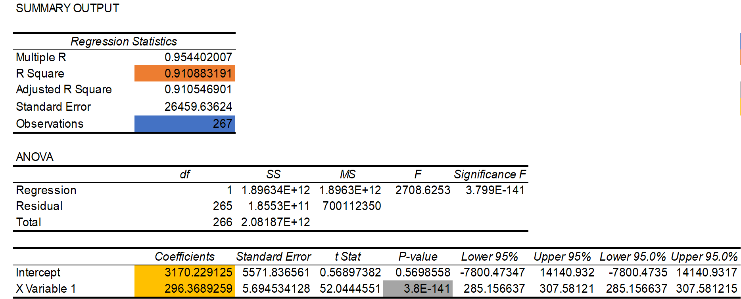
Regression Table

Slide 28
Simple Linear Regression
Exercise in R
ŷ = bο + b₁ x ₁
Salary = bο + b₁ (YearsExperience)
Y = a
Scatterplot
Definition
Basic concepts
Significance, Variance, Coefficients
Geometrical representation
Application in R
Interpretation of results
Synthesis

Slide 29
Simple Linear Regression
Exercise in R
Salary = bο + b₁ (YearsExperience)
ŷ = 25,792 + 9,450 * YearsExperience
Results and Interpretation
Definition
Basic concepts
Significance, Variance, Coefficients
Geometrical representation
Application in R
Interpretation of results
Synthesis

Slide 30
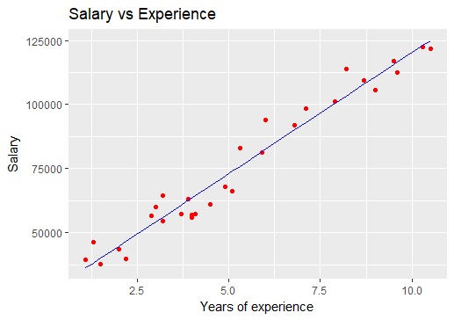
Simple Linear Regression
Exercise in R
ŷ = 25,792 + 9,450 * YearsExperience
Definition
Basic concepts
Significance, Variance, Coefficients
Geometrical representation
Application in R
Interpretation of results
Synthesis

Slide 31
Linear Regression
Key OLS Assumptions
Linearity
No endogeneity
correlation of errors and x variables
Omitted variable bias
random sampling and normality
Spherical errors:
There is homoscedasticity (constant variance)
no autocorrelation.
There is no multicollinearity (or perfect collinearity)
Basic concepts
Definition
Geometrical representation
Line of best fit
Notes:
OLS = MIN SSE (will be discussed later on )
Finding the line of best fit through OLS means determing the line (among many lines that can fit our data) with less error.
This is a minimization problem using Calculus and Algebra so I will not elaborate on this.
OLS is a powerful method in finding the best fit line
Error is the difference between prediction and reality: the vertical distance between a real data point and the regression line. OLS is concerned with the squares of the errors. It tries to find the line going through the sample data that minimizes the sum of the squared errors. Below, the squared errors are represented as squares, and your job is to choose betas (the slope and intercept of the regression line) so that the total area of all the squares (the sum of the squared errors) is as small as possible. That's OLS! Website: http://setosa.io/ev/ordinary-least-squares-regression/
B coefficients are found by minimizing the error of the prediction
But how do we actually minimize the error?

Slide 32
Multiple Regression Analysis

Slide 33
Multiple Regression
Multiple Regression Equation
y = b₀ + b₁ x ₁ + b₂ x ₂ + b₃ x ₃ …. b_{n} x_{n}
OLS Assumptions
Adjusted R²
F test, p-value
Definition
Basic concepts
Coefficients
Application in R
Interpretation of coefficients/results
Synthesis

Slide 34
Multiple Regression
How to build a multiple regression model
Backward Elimination
Forward Selection
Bidirectional
Score comparison
Definition
Basic concepts
Coefficients
Application in R
Interpretation of coefficients/results
Synthesis

Slide 35
Multiple Regression
Exercise in R
Model and equation
Results and Interpretation
Definition
Basic concepts
Coefficients
Application in R
Interpretation of coefficients/results
Synthesis

Slide 36
Multiple Regression
Regression in R Case
Objective
The objective of this project is to analyze is to analyze the effect of education and other variables on individual earnings or wage (per hour) through a cross sectional analysis, involving dataset from a household survey on Italian workers sourced from the Bank of Italy.
Other variables:
years of experience
education of parents
gender
location of residence
employment in which type of sector
employment status
Definition
Basic concepts
Coefficients
Application in R
Interpretation of coefficients/results
Synthesis

Slide 37
Multiple Regression
Regression in R
Addressing the following questions:
1) Which variables are the most correlated? Are there any variables that are particularly highly correlated? What would be the issue of including both of these measures in a regression with wages as the dependent variable?
2) What is the effect of education on individual earnings or wage?
3) What would be the average wage implied by your model for an individual with 8 years of schooling? What about for an individual with 18 years of schooling?
4) Estimate via OLS a complete model in which the hourly (log) wage is regressed on gender, marital status, education, experience, location, and employment status and sectors.
Definition
Basic concepts
Coefficients
Application in R
Interpretation of coefficients/results
Synthesis

Slide 38
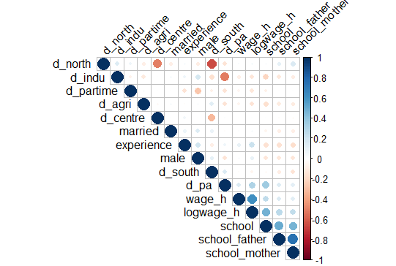
Multiple Regression
Regression in R Case
Correlation
Definition
Basic concepts
Coefficients
Application in R
Interpretation of coefficients/results
Synthesis
Multicollinearity exists whenever two or more of the predictors in a regression model are moderately or highly correlated.

Slide 39
Multiple Regression
Regression in R Case
Effect of education on wage per hour
Wage = b₀ + b₁ *education or years of schooling
Definition
Basic concepts
Coefficients
Application in R
Interpretation of coefficients/results
Synthesis
ŷ = 4.074 + 0.617 * education or years of schooling

Slide 40
Multiple Regression
Regression in R Case
Comparison of the wages per hour of individuals with 8 years of schooling and 18 years of schooling using the regression model:
ŷ = 4.074 + 0.617 * education or years of schooling
an individual with 8 years of schooling would have a 9 euro corresponding wage per hour
an individual with 18 years of schooling would have a 15 euro corresponding wage per hour.
Definition
Basic concepts
Coefficients
Application in R
Interpretation of coefficients/results
Synthesis

Slide 41
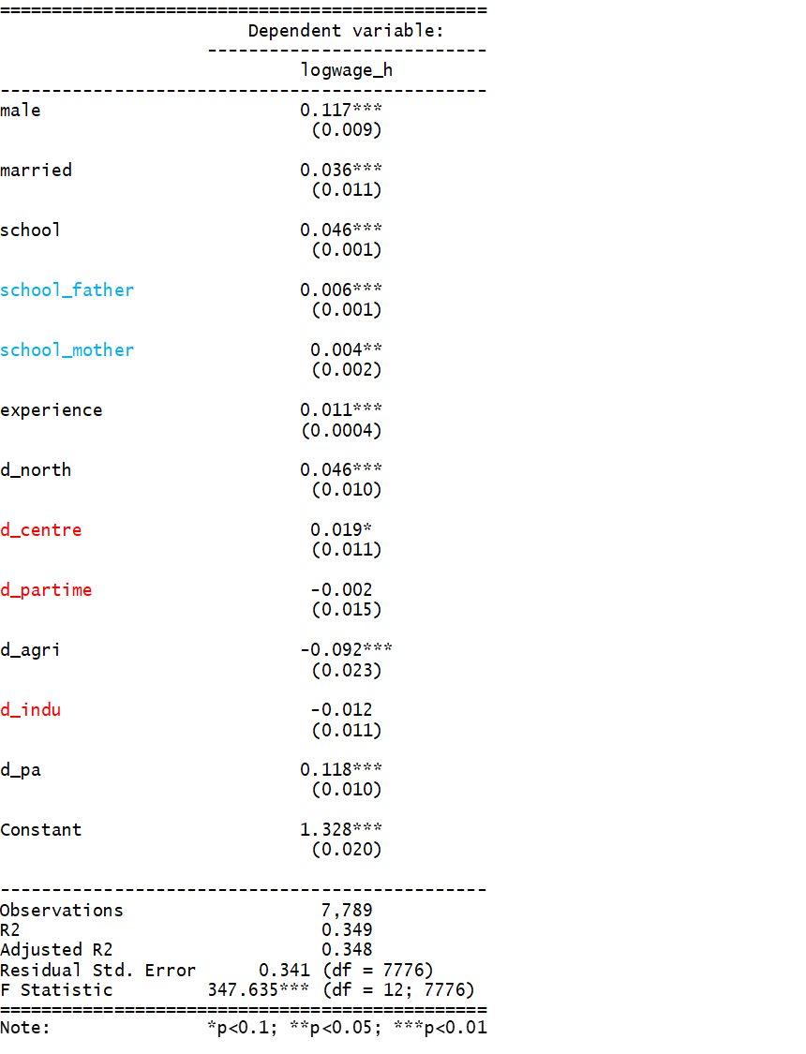
Regression in R Case
First regression
y = b₀ + b₁ x ₁ + b₂ x ₂ + b₃ x ₃ …. b_{n} x_{n}
Notes:
This model is in log-level, so the estimated coeﬃcients for each regressor represent the semi-elasticity of the wage with respect to each regressor. The semi-elasticity is the % change in y due to an absolute change in X.
Each estimate for the dummies β represents the direct eﬀect on the dependent variable of each single regressor. The direct eﬀect is the change in the mean average of the dependent variable log(wagei) due to a change in one regressor when all the other are kept ﬁxed.
β0 represents the level of wage of the omitted cathegories, that is being female, unmarried, located in the central regions

Slide 42
Regression in R Case
2nd regression
y = b₀ + b₁ x ₁ + b₂ x ₂ + b₃ x ₃ …. b_{n} x_{n}
y = b₀ + b₁ males + b₂ school + b₃ married + b₄ experience + b₅ d_north + b₆d_agri + b₇d_pa
Notes:
This model is in log-level, so the estimated coeﬃcients for each regressor represent the semielasticity of the wage with respect to each regressor. The semielasticity is the % change in y due to an absolute change in X.
Each estimate for the dummies β represents the direct eﬀect on the dependent variable of each single regressor. The direct eﬀect is the change in the mean average of the dependent variable log(wagei) due to a change in one regressor when all the other are kept ﬁxed.
β0 represents the level of wage of the omitted cathegories, that is being female, unmarried, located in the central regions

Slide 43
Regression Analysis in R
Presentation for R-Ladies Milan
Ana Peña

Slide 44
Multiple Regression
Synthesis
There must be linear relationship between independent and dependent variables
Multiple regression suffers from multicollinearity, autocorrelation, heteroskedasticity.
Linear Regression is very sensitive to Outliers. It can terribly affect the regression line and eventually the forecasted values.
Multicollinearity can increase the variance of the coefficient estimates and make the estimates very sensitive to minor changes in the model. The result is that the coefficient estimates are unstable
In case of multiple independent variables, we can go with forward selection, backward elimination and step wise approach for selection of most significant independent variables.
Definition
Basic concepts
Coefficients
Application in R
Interpretation of coefficients/results
Synthesis

